Slide 1
Instructions
Treatment 1:
Human arbitrator
You have exactly 15 minutes to go through the instructions. You will have enough time to read the instructions carefully. A printed summary of the instructions will be given to you at the end of the instruction round.
The experiment will take place through computer terminals at which you are seated. If you have any questions either during the instruction period or after the experiment has begun, raise your hand and an assistant will come by to answer your question.
The experiment will take about 25 minutes to finish.
While the experiment is ongoing, please refrain from closing this window or navigating away from this page. Doing so will prevent you from restarting, and unfortunately, we won't be able to compensate you

Slide 2
Instructions
This is an experiment in decision making on production and negotiation. What you earn depends on your decisions and the decisions of others.
The experiment will start with one practice period for familiarizing with the tool. Then, there will be three periods in which you can win points.
In each period there will be a task regarding the production and another regarding negotiation.
Once you have finished all periods, you will be prompted to fill out a short survey. Subsequently, you will receive an overview of your cumulative earnings across all rounds. Your earned points will be exchanged for actual money (50 points = 1€). In addition to your point-based earnings, you will also receive a participation flat fee of 1.5€. Your total earnings will be delivered then to you via the Lydia app.
Before beginning, a brief quiz will be administered to assess your comprehension of the tasks
Click “Next” if you have understood the instructions.

Slide 3
Roles and Matching
In the experiment there are two types of roles, referred to as workers and manager, who will make decisions on behalf of a fictional company regarding their remunerations in a professional environment. Participants will work by groups of 2 workers, that will be randomly changed in each period.
You will be randomly assigned to one of these roles at the beginning of the experiment, and you will keep this role for the entire time.

Slide 4
Instructions: Production task (1)
Period 1 of 4
You have been matched with another worker for your group.
This task consists of four rounds that will run simultaneously.
At the start of every round, each group member will receive 20 points per round. It's up to you to decide how many of those 20 points you wish to allocate to the group project. The points you choose not to contribute will remain just for you.
The points contributed to the group project will be added to both group members. The total group points will be multiplied by a price that will be negotiated in the following task. In the practice period, this multiplier will be 1.00 ECU (Experimantal Currency Unit)

Slide 5
Instructions: Production task (2)
The other worker in your group will also have to decide within the same amount of time.
You have three minutes in total.
You cannot chat as it is an individual decision.
You will not see the decisions of the other worker.
Once all group members have made their decisions, the result screen will be presented to you. On this screen, you will find information about the number of points you have earned. After the result screen, the negotiation task will start.

Slide 6
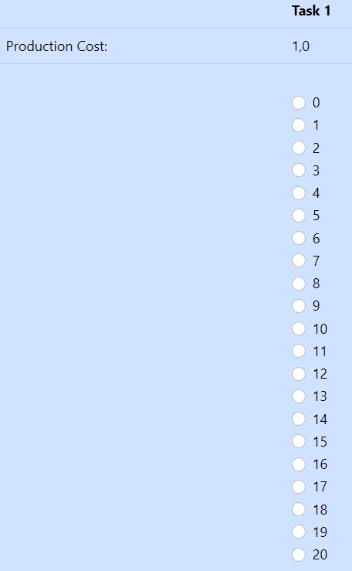
Instructions: Production task (2)
Example round 1.
“Task” to be changed to “Round”
Each worker has 20 points at the beginning of each round
Worker A
Worker B
See if it could work to offer 5 instead of 20
Delete row ”production cost”
Add: Points to be contributed to the group
For the example player A check: 20
For the example player A check: 8
Worker A contributes 8 points
Worker B contributes 20 points

Slide 7
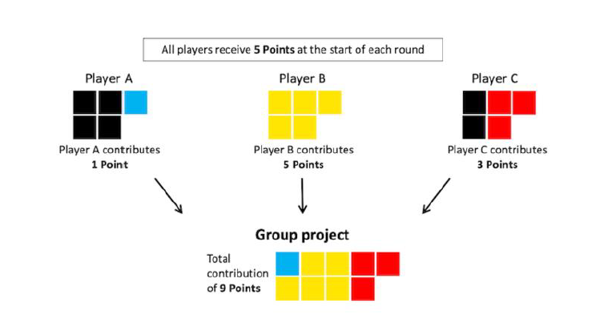


Instructions: Example of one round.
Both workers will receive at the beginning
5 points for each round.
Round 1:
Worker A
Worker B
Worker A
Worker
of 6 points
Worker A
Worker B
Kept
Group
Kept
Group
Notes:
PROPOSAL REFERENCE PAPER
Based on the reference paper of PGG, with a group of 2 players and 5 available units per round, the display instructions were:

Slide 8
Instructions: Negotiation task (1)
You will have to decide a production cost price that will multiply the points for the contributed points in the former production task.
The potential prices are shown in the following grid which is composed by four rounds equivalent to the former production task. Each round has nine alternatives (from “A” to “I”) equivalent to a price.
You and your group member have to try to find an agreement on the price’s alternative in the four rounds within the total time (30 seconds for the trial period). The agreement must correspond to the same alternative. E.g.: Round 1: you: alternative C, the other group member: alternative C.
For the trial period, all prices are the same for you and the other group member (1.00 ECU). Therefore, all alternatives are the same.

Slide 9
Instructions: Negotiation task (2)
You will not see the former contributed points.
You can chat via the computer. You can disclose payoffs. Any rude, racist, or disclosing of your identity risks immediate expulsion with no payoff.
At the end of the time, each of you must submit the letter of the alternative of each task.
For the trial period, as prices are the same. Therefore, we will suppose that you have reached an agreement.

Slide 10


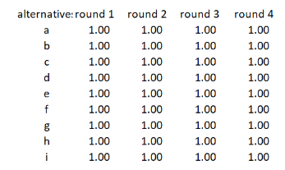
Instructions: Negotiation task (3)
Screen for chatting
Task
Your role
Label & Group
Period
Timer: mm: ss
NEGOTIATION
Worker 1 –Group 1
Period 1 of 4
If you want to chat, write in the square after “you”
Instructions
You:
SEND
1. Move the slider of the alternative of the Price you agree for the contribution. Select one per round and click on the Submit button
Chat. Scroll up or down with the arrows if requiered
Chat
You: ….
Worker 2: ….
Summary:
Round 1
Round 2
Round 3
Round 4
Your alternative letter
The Price of your alternative
SUBMIT
Simulation of production cost
Submit
Your decision summary

Slide 11
WORKERS: COMPREHENSION QUIZ
In Corgnet, Dismissal: Incentivized so that participants who answered all questions correctly in their first attempt received a 1-euro bonus
4 Q: van den Berg et al, 2020, Scientific Reports
Read and answer the following comprehension questions. Only one answer per question is correct. Once finished, click on the “submit” button. In case of wrong answer/s, the incorrect question/s will be shown again in order to try to answer again and submit. You will have the possibility to answer up to 10 times. For participating in the experiment, all answers must be answered correctly. The aim is to ensure the correct understanding of the instructions. (in bold the correct answer)
How are the pair’s production units distributed among the workers in the pair?
The worker who contributes more to the pair will receive more points
The worker who contributes less to the pair will receive more points
It will be distributed evenly among the workers of the pair
It will be randomly distributed between the workers of the pair
Select the correct end of the following sentence?: “the worker that contributes more than cero units un a task will …”
Get more than 5 points
Get the points the worker contributed
Depend on the points contributed by the other worker of the pair
In which of the following cases a worker will receive more points? Case 1: both workers contributed 0 points. Case 2: both workers contributed 3 points
In case 1
In case 2
In both cases the workers will receive the same amount of points.
In which of the following cases a worker will receive more points? Case 1: the other worker contributed 12 points, but you contributed 0. Case 2: both workers contributed 6 points
In case 1
In case 2
In both cases the workers will receive the same amount of points
In bold, correct answers. Not to be shown to participants
If total points per round is 5
In Van der Berg 4Q (teams of 3 workers). The 4th:Both your fellow group members contributed 3 Points, but you contributed 0 Points. 2. All three group members contributed 3 Points. As we have 2 workers, no sense; so I modified and added 1Q
Submit

Slide 12
Instruction period has ended. May you have any doubt, please reach the assistant. If everything is clear, you can start the experiment. Going forward, the points you accumulate will impact your final earnings. Once you're paired with another worker for your group, you can begin. Please be patient and wait until your group member has read the instructions and finished the quiz, which might take a while. Important reminder: do not close this window. The periods will commence as soon as your group member is prepared. Keep in mind that there's a time limit. Next screen will be a short survey:

Slide 13
Survey: EMO
In red the 8 feelings for having 2 EMOs: Hp and Fear (not 20
Please rate very carefully the degree to which you are currently experiencing each of the following feelings (circle a number):
1: Do not feel at all, 9: Feel stronger than ever have
Joyful 1 2 3 4 5 6 7 8 9
Afraid 1 2 3 4 5 6 7 8 9
Elated 1 2 3 4 5 6 7 8 9
Hopeful1 2 3 4 5 6 7 8 9
Scared 1 2 3 4 5 6 7 8 9
Mad 1 2 3 4 5 6 7 8 9
Disgusted 1 2 3 4 5 6 7 8 9
Revolted 1 2 3 4 5 6 7 8 9
Irritated 1 2 3 4 5 6 7 8 9
Blue 1 2 3 4 5 6 7 8 9
Repulsed 1 2 3 4 5 6 7 8 9
Delighted 1 2 3 4 5 6 7 8 9
Angry 1 2 3 4 5 6 7 8 9
Gloomy1 2 3 4 5 6 7 8 9
Ashamed 1 2 3 4 5 6 7 8 9
Nervous 1 2 3 4 5 6 7 8 9
Upset 1 2 3 4 5 6 7 8 9
Happy 1 2 3 4 5 6 7 8 9
Nauseated 1 2 3 4 5 6 7 8 9
Sad 1 2 3 4 5 6 7 8 9
Click to continue.
You can also use the ⬅ & ➔ keys in the keyboard to go back and forward.

Slide 14
Trial Period (1/4) Production task (1)
Group members have been shuffled. You have been matched with another worker for your group.
This task consists of four rounds that will run simultaneously.
At the beginning, each group member will receive 20 points per round. It's up to you to decide how many of each 20 points you wish to allocate to the group project per round. The points you choose not to contribute will remain for yourself.
The points contributed to the group project will be added to both group members. The total group points will be multiplied by a price that will be negotiated in the following task. In the practice period, this multiplier will be 1.00

Slide 15
Trial Period (1/4) Production task (2)
The other worker in your group will also have to decide within the same amount of time.
You have three minutes in total.
Instructions are similar to the trial period.
You cannot chat as it is an individual decision.
You will not see the decisions of the other worker.
Once all group members have made their decisions, the result screen will be presented to you. On this screen, you will find information about the number of points you have earned. After the result screen, the negotiation task will be with the same group members.

Slide 16
Trial Period (1/4) Production task: summary
Instructions:
Summary:
Period 1 of 3
Round 1
Round 2
Round 3
Round 4
All 4 rounds
Negotiated Price per point (ECUs)
1.00
1.00
1.00
1.00
Points kept for you –A-
Your contribution to the group (points)
Other group member’s contribution (points)
Total group Project contribution (points)
Total group Project contribution multiplied by negotiated Price (points) –B-
Total points individual –A- plus group with multiplier -B-
Your total points for this period

Slide 17
Trial Period (1/4) Negotiation task (1)
Instructions:
You will have to decide a production cost price that will multiply the points for the contributed points in the former production task.
The potential prices are shown in the following grid which is composed by four rounds equivalent to the former production task. Each round has nine alternatives (from “A” to “I”) equivalent to a price.
Each worker has a different cost grid. Therefore, prices are different within the group.
You and your group member have to try to find an agreement on the price’s alternative in the four rounds within the total time (5 minutes). The agreement must correspond to the same alternative. E.g.: Round 1: you: alternative C, the other group member: alternative C.
You can agree on the same or choose different alternatives for the different rounds.

Slide 18
Trial Period (1/4) Negotiation task (2)
Instructions:
You will not see the former contributed points.
You can chat via the computer. You can disclose payoffs. Any rude, racist, or disclosing of your identity risks immediate expulsion with no payoff.
At the end of the 5 minutes, each of you must submit the letter of the alternative of each task.
The computer will detect whether there is an agreement in all tasks.
If there is no full agreement, a human manager will decide for the group the cost for each round following the best option for the company, being the same alternative for both workers.

Slide 19
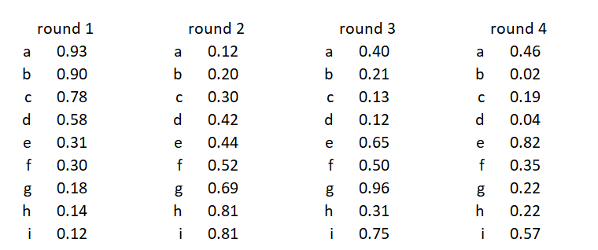

:
Trial Period (1/4)Negotiation task (3)
Screen for chatting
Task
Your role
Label & Team
Period
Timer: mm: ss
NEGOTIATION
Worker 1 –Team 1
Period 1 of 4
If you want to chat, write in the square after “you”
Instructions
1. Move the slider of the alternative of the Price you agree for the contribution. Select one per round and click on the Submit button
You:
SEND
Chat. Scroll up or down with the arrows if requiered
Chat
You: ….
Worker 2: ….
Summary:
Round 1
Round 2
Round 3
Round 4
Your alternative letter
The cost of your alternative
No agreement
No agreement
No agreement
No agreement
SUBMIT
Simulation of production cost
Submit
Your decision summary

Slide 20
Trial Period (1/4) Negotiation task: summary
Instructions:
Summary:
Period 1 of 4
You have (not) reached an agreement.
Prices shown are the ones decided by your group (Human manager)
Round 1
Round 2
Round 3
Round 4
All 4 rounds
Your final price (ECUs)
1.00
1.00
1.00
1.00
Total group Project contribution (points)
Total group Project contribution multiplied by final Price (points) –B-
Your total points for this period

Slide 21
Survey: EMO
In red the 8 feelings for having 2 EMOs: Hp and Fear (not 20
Please rate very carefully the degree to which you are currently experiencing each of the following feelings (circle a number):
1: Do not feel at all, 9: Feel stronger than ever have
Joyful 1 2 3 4 5 6 7 8 9
Afraid 1 2 3 4 5 6 7 8 9
Elated 1 2 3 4 5 6 7 8 9
Hopeful1 2 3 4 5 6 7 8 9
Scared 1 2 3 4 5 6 7 8 9
Mad 1 2 3 4 5 6 7 8 9
Disgusted 1 2 3 4 5 6 7 8 9
Revolted 1 2 3 4 5 6 7 8 9
Irritated 1 2 3 4 5 6 7 8 9
Blue 1 2 3 4 5 6 7 8 9
Repulsed 1 2 3 4 5 6 7 8 9
Delighted 1 2 3 4 5 6 7 8 9
Angry 1 2 3 4 5 6 7 8 9
Gloomy1 2 3 4 5 6 7 8 9
Ashamed 1 2 3 4 5 6 7 8 9
Nervous 1 2 3 4 5 6 7 8 9
Upset 1 2 3 4 5 6 7 8 9
Happy 1 2 3 4 5 6 7 8 9
Nauseated 1 2 3 4 5 6 7 8 9
Sad 1 2 3 4 5 6 7 8 9
Click to continue.
You can also use the ⬅ & ➔ keys in the keyboard to go back and forward.

Slide 22
Period (2/4) Production task (1)
You have been matched with another worker for your group.
This task consists of four rounds that will run simultaneously.
At the beginning, each group member will receive 20 points per round. It's up to you to decide how many of each 20 points you wish to allocate to the group project. The points you choose not to contribute will remain just for you.
The points contributed to the group project will be added to both group members. The total group points will be multiplied by a price that will be negotiated in the following task. In the practice period, this multiplier will be 1.00 ECU

Slide 23
Period (2/4) Production task (2)
The other worker in your group will also have to decide within the same amount of time.
You have three minutes in total.
You cannot chat as it is an individual decision.
You will not see the decisions of the other worker.
Once all group members have made their decisions, the result screen will be presented to you. On this screen, you will find information about the number of points you have earned. After the result screen, the negotiation task will be with the same group members.

Slide 24
Period (2/4) Production task: summary
Summary:
Period 2 of 4
Round 1
Round 2
Round 3
Round 4
All 4 rounds
Units kept for you )points) –A-
Your contribution to the group (points)
Other group member’s contribution (points)
Total group Project contribution (points)
Total group Project contribution multiplied by negotiated Price (points) –B-
Total points individual –A- plus group with multiplier -B-
Your total points for this period

Slide 25
Periods (2/4) Negotiation task (1)
You will have to decide a production cost price that will multiply the points for the contributed units in the former production task.
The potential prices are shown in following grid which consists of four rounds equivalent to the former production task. Each round has nine alternatives (from “A” to “I”) equivalent to a price.
Each worker has a different cost grid. Therefore, prices are different within the group.
You and your group member have to try to find an agreement on the price’s alternative in the four rounds within the total time (5 minutes). The agreement must correspond to the same alternative. E.g.: Round 1: you: alternative C, the other group member: alternative C.
You can agree on the same or choose different alternatives for the different rounds.

Slide 26
Period (2/4) Negotiation task (2)
You would not see the former contributed points.
You can chat via the computer. You can disclose payoffs. Any rude, racist, or disclosing of your identity risks immediate expulsion with no payoff.
At the end of the 5 minutes, each of you must submit the letter of the alternative of each task
The computer will detect whether there is an agreement in all tasks and will show it to you.
If there is no full agreement, a human manager will decide for the group the cost for each round following the best option for the company, being the same alternative for both workers.

Slide 27
Period (2/4) Negotiation task (3)
Screen for chatting
Task
Your role
Label & Team
Period
Timer: mm: ss
NEGOTIATION
Worker 1 –Team 1
Period 2 of 4
If you want to chat, write in the square after “you”
Instructions
1. Move the slider of the alternative of the Price you agree for the contribution. Select one per round and click on the Submit button
You:
SEND
Chat. Scroll up or down with the arrows if requiered
Chat
You: ….
Worker 2: ….
Summary:
Round 1
Round 2
Round 3
Round 4
Your alternative letter
The cost of your alternative
No agreement
No agreement
No agreement
No agreement
SUBMIT
Simulation of production cost
Submit
Your decision summary

Slide 28

Period (2/4) Negotiation task (4)
Screen for chatting
Task
Your role
Label & Team
Period
Timer: mm: ss
NEGOTIATION
Worker 1 –Team 1
Period 2 of 4
If you want to chat, write in the square after “you”
Instructions
You:
SEND
Chat. Scroll up or down with the arrows if requiered
1. Move the slider of the alternative of the production cost Price (ECUs) you agree for the contribution. Select one per round and click on the Submit button
Chat
You: ….
Worker 2: ….
Summary:
Round 1
Round 2
Round 3
Round 4
Your alternative letter
e
i
g
f
The cost of your alternative
0.31
0.81
0.96
0.35
No agreement
No agreement
No agreement
No agreement
SUBMIT
Selection of production cost price (ECUs) to contribute per round
Submit
Your decision summary

Slide 29
Period 2/4 Negotiation task: summary
Summary:
Period 2 of 4
You have (not) reached an agreement.
Prices shown are the ones decided by your group (Human manager)
Round 1
Round 2
Round 3
Round 4
All 4 rounds
Your final price (ECUs)
1.00
1.00
1.00
1.00
Total group Project contribution (points)
Total group Project contribution multiplied by negotiated Price (points) –B-
Your total points for this period

Slide 30
You have finished the four periods.
Before we disclose your final earnings, please answer the following short survey.

Slide 31
Survey: SocioDemo 1
Write your nationality. (free text/ dropdown)
What is your gender? Select one option
Dropdown: Female, Male, Prefer not to say
What is your current age today? (Write a number, e.g.: 27). (free text/ dropdown)
What is the maximum level of completed studies? Select one option
Dropdown: Primary School, Secondary School, Vocational Training, Graduate or Bachelors Degree Master/ Postgraduate degree, Ph.D., Other:
Click to continue.
You can also use the ⬅ & ➔ keys in the keyboard to go back and forward.

Slide 32
Survey: SocioDemo 2
What field of university studies do you have? Select one option
Dropdown: None, Law, Economics/ Business/ Management, STEM ( Science, Technology, Engineering or Mathematics), Other
What sector do you have professional experience in? Select one option
Dropdown: None, Public, Private, Public and Private
How many years of professional experience you have? (write a number -round up to no decimals-, from 0 if no negotiation experience to total number of years you may have). E.g.: if two years and a half, write: 3. (free text/dropdown)
Click to continue.
You can also use the ⬅ & ➔ keys in the keyboard to go back and forward.

Slide 33
Survey: SocioDemo 3
How many years of negotiating experience do you have? (write a number, from 0 if no negotiation experience to whichever number of years you may have; -round up to no decimals-). E.g.: if two years and a half, write: 3 (free text)
next
Click to continue.
You can also use the ⬅ & ➔ keys in the keyboard to go back and forward.

Slide 34
Survey: Work satisfaction
Please read each statement and select the appropriate number, based on the following scale: 5 = strongly agree, 4 = somewhat agree, 3 = neutral, 2 = somewhat disagree, 1 = strongly disagree.
I really enjoyed doing this task.
This task was fun to do.
I thought it was a boring task.
I found this task quite enjoyable.
From Corgnet 2023, Dismissal paper. (adapted from Ryan, 1982)
How do we show the 5-point Likert scale: /Brice: 7 Likert
Slider, scale dropdown and select the choice, other
next

Slide 35
Perceived Justice
Please read each statement and decide how much you agree or disagree with its content. Then select the appropriate number, based on the following scale: 5 = strongly agree, 4 = agree, 3 = neutral (neither agree nor disagree), 2 = disagree, 1 = strongly disagree.
I would feel uncomfortable in a job where I had to use robots artificial intelligences.
The word “robot artificial intelligences” means nothing to me.
I hate the idea that robots or artificial intelligences or algorithms can make judgments on people.
I would feel very nervous in front of a robot.
I would feel anxious if I had to talk to a robot.
From Corgnet 2023, Dismissal. (adapted from Colquitt, 2001)
How do we show the 5-point Likert scale:
Slider, scale dropdown and select the choice, other
NEXT

Slide 36
Experiment: earnings summary
You have finished the experiment. Thank you for your participation.
Your final payoff will be as following:
Your total points earned in the experiment are (points):
Based on the equivalence of 50 points = 1€, you have earned (euros):
The participation fee is = 1.5
Your total earnings of today are (euros)
For getting your earnings, please write down this unique code for you. This code will be asked for giving you your payoff via Lydia app:
Once you have noted your code, please close the window

Slide 37
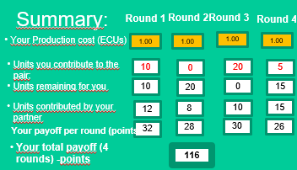
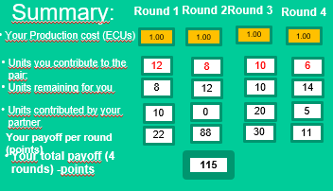
Production task: example(2)
Instructions:
Suppose you contribute 10 units for Round 1, 0 unit in Round 2, 20 units in Round 3, and 5 units in Round 4. To confirm your contribution, click on the “Submit” button.
Suppose your teammate contributed 12 units for Round 1, 8 units in Round 2, 10 units in Round 3, and 15 units in Round 4.
Your final payoff for the period will be:
For you: For your teammate (you won’t see their screen):

Slide 38
PROPOSAL REFERENCE PAPER
In the instructions of the reference paper of PGG, with a group of 3 players and 5 available units per round, the display instructions were:

Slide 39
Production task (2)
Instructions:
Your payoff for the task will be the sum of your cash and team production of each round.
Your cash for each round will be the units you kept for yourself, and team production is the sum of the units you and your teammate contributed multiplied by your cost (value?) of production (in ECUs - Experimental Currency Units-). That is:
Round Payoff: your cash + cost per unit x (units you produced contributed + units your teammate produced)
At the end of each period, you will see a summary screen with units contributed by yourself and your partner and your payoff in this period.

Slide 40
Production task: example (1)
Instructions:
Suppose you are Worker 1 in Group 1
You must decide the units to contribute to the four rounds. You will have a certain amount of time.
At the end of time, you will see the Summary with units contributed by yourself and your partner and the points you earned in this period.
Suppose that the production cost is 1.00 ECU for both of you is the same in the four rounds

Slide 41
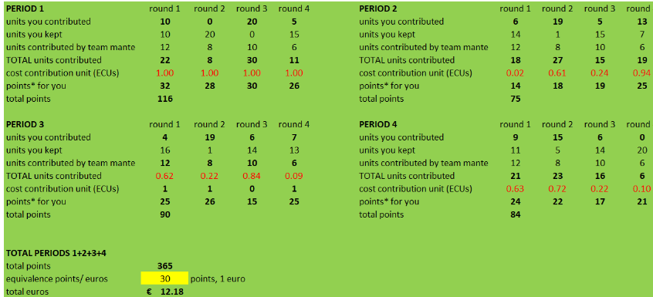
Instructions:
Simulation: Your final payoff will be:
Task
Your role
Label & Team
Period
Timer: mm: ss
PAYOFF
Worker 1 –Team 1
Period 4 of 4
Congratulations! You have finished the experiment.
The points calculation per period is the sum of units you kept for yourself + cost contribution unit x (units you shared + units your teammate shared), for the four round.
Following the screen, for Period 1, round 1 =
10 units kept + 1.00 ECUs x (10 you contributed + 12 units your teammate contirbuted)
10 units kept + 1.00 ECUs x (22 units contributed to the teamn) = 32
The total amount of your payoff in euros will be given in an Amazon Gift card before you leave

Slide 42
PENDING
Pendings
Time : instrs + prod +nego
Instr:_ Manager, treatment no arbitr + algo treatment
Real prod/ nego: change in prod
Survey:
Emo: which
SD, aversion, CRT, social
Calibration :
Times instrs + prod +nego + human manager
Gather all payoffs
Register chat
Points/€
Random nego: columns and order of rows.
PENDING
Doubts
Order instructions: prod > nego. Really > nego +prod. (first nego 1€)
Team? Teammate?
Production :
Show example of cero contribution, with sabotage (not for now)
summary: earnings? Points?
How to show sabotage, no decimals: -20, -1
Show cumul nego + prod/ only at the end
Changes of team: only in prod?
Human manager before experiment
Ethic committee
Time, cost Castellón, CIII

Slide 43
Instructions:
Overview of your screen on Production task (1)
Task
Your role
Label & Team
Timer: mm: ss
Selection of units to contribute
Period
Total earnings
PRODUCTION
Worker 1 – Team. 1
Period 1 of 4
Simulation of production cost
Instructions
1. Move the slider of the units you want to contribute to the team for each round.
2. Click the submit button with your final decision
Round 1
Round 2
Round 3
Round 4
Your Production cost (ECUs)
Units to contribute:
1
2
3
4
5
6
7
8
9
10
11
12
13
14
15
16
17
18
19
20
1.00
1.00
1.00
1.00
Summary:
Round 1
Round 2
Round 3
Round 4
Your Production cost (ECUs)
1.00
1.00
1.00
1.00
Units you contribute to the pair:
Units remaining for you
Units contributed by your partner
Your payoff per round (points)
Your total payoff (4 rounds) -points
SUBMIT
Submit
In following productions rounds, show the historic or just the completed round and at the end, the total. Don’t put in example,

Slide 44
Instructions:
Overview of your screen on Production task (2)
Task
Your role
Label & Team
Timer: mm: ss
Selection of units to contribute (simulation)
Period
Total Earnings
PRODUCTION
Worker 1 – Team. 1
Period 1 of 4
Instructions
1. Move the slider of the units you want to contribute to the team for each roun.
2. Click the submit button with your final decision
Round 1
Round 2
Round 3
Round 4
Your Production cost (ECUs)
Units to contribute:
0
1
2
3
4
5
6
7
8
9
10
11
12
13
14
15
16
17
18
19
20
1.00
1.00
1.00
1.00
Summary:
Round 1
Round 2
Round 3
Round 4
Your Production cost (ECUs)
1.00
1.00
1.00
1.00
Units you contribute to the pair:
10
0
20
5
0
20
Units remaining for you
10
20
0
15
Units contributed by your partner
Your payoff per round (points)
Your total payoff (4 rounds) -points
SUBMIT
Submit

Slide 45
Overview of your screen on Production task (3)
Task
Your role
Label & Team
Timer: mm: ss
Selection of units to contribute
Period
Total Earnings
PRODUCTION
Worker 1 – Team. 1
Period 1 of 4
Simulation of production cost
Instructions
1. Move the slider of the units you want to contribute to the team for each roun.
Round 1
Round 2
Round 3
Round 4
Your Production cost (ECUs)
Units to contribute:
1
2
3
4
5
6
7
8
9
10
11
12
13
14
15
16
17
18
19
20
1.00
1.00
1.00
1.00
Summary:
Round 1
Round 2
Round 3
Round 4
Your Production cost (ECUs)
1.00
1.00
1.00
1.00
Units you contribute to the pair:
10
0
20
5
Units remaining for you
0
10
20
15
Units contributed by your partner
12
8
10
15
32
28
30
26
Your payoff per round (points)
Your total payoff (4 rounds) -points
116
I don’t want to contribute:
I want to sabotage
(negative units of production):
Write a number between -20 and -1

Slide 46
Overview of your screen on Negotiation task (2)
Task
Your role
Label & Team
Period
Timer: mm: ss
In case of total agreement in alternatives
NEGOTIATION
Worker 1 –Team 1
Period 1 of 4
Congratulations! You have reached an agreement for all rounds.
Your production costs (ECUs) per round are:
Summary:
Round 1
Round 2
Round 3
Round 4
The cost of your alternative
0.31
0.81
0.96
0.35
Task
Your role
Label & Team
Period
Timer: mm: ss
In case of no agreement in all alternatives: arbitration by a human manager
NEGOTIATION
Worker 1 –Team 1
Period 1 of 4
There has not been an agreement. Your(human manager has decided the following production costs (ECUs( for you=:
Round 1
Round 2
Round 3
Round 4
The cost of your alternative
0.50
0.59
0.96
0.35

Slide 47
Negative Attitudes towards Robots Scale (NARS)
Please read each statement and select the appropriate number, based on the following scale: 5 = very much, 4 = somewhat, 3 = neutral, 2 = not much, 1 = not at all. Once finished, click on the Submit button at the bottom.
Does your pay reflect the effort you put into your work?
Does your pay match the work you have done?
Is your pay justified, given your performance?
From Corgnet 2023, Dismissal paper. (adapted from Colquitt, 2001)
How do we show the 5-point Likert scale:
Slider, scale dropdown and select the choice, other
SUBMIT

